Slide 1
Revisiting NI
Rune Ibsen
Notes:
NI Inception Event, 09/07/2014

Slide 2


2007
2008
2009
2010
2011
2012
2013
2014
Notes:
I have worked with a large number of other clients in all sorts of areas: government institutions, retailers, the Danish railway company and a couple of tech startups. Oli encouraged me to reflect on how working with these clients was different from working with NDS / Cisco and on what, if anything, Cisco can learn from these companies.

Slide 3
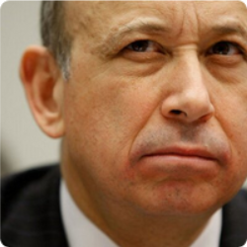
”The grass is greener on the other side because it’s fertilized with bullshit”
@GSElevator
Notes:
Most of the other clients I have worked with have not been tech companies and as such, I don’t think they can teach you anything at all about technology or software development. You are all highly skilled, most of you are engineers with years of experience. You know how to develop software, you know your technology and your tools, and Frank Olsen and others make sure that you have your agile processes pretty well established. Most of my other clients would be lucky to ever hire one of you.
So, when Friday afternoon comes around and you go to the pub, and you sit there and have a few pints and chat about how everyone else are idiots – we all do that, don’t we - I think there is a pretty good chance that you are actually right!
As I thought more about what set you apart from the people I’ve worked with at other clients I realised, that you have much more passion for technology, and that that is what makes working with you so much more enjoyable. That is something that I really envy you, and I hope that you appreciate how fortunate you are: you are all highly skilled and passionate about technology, and because you are passionate and proud, you want to deliver quality, i.e. you are responsible and dependable. You really need to appreciate how lucky you are to be working with colleagues who are skilled and passionate about technology. That is a rare luxury and I really hope that you appreciate it.

Slide 4
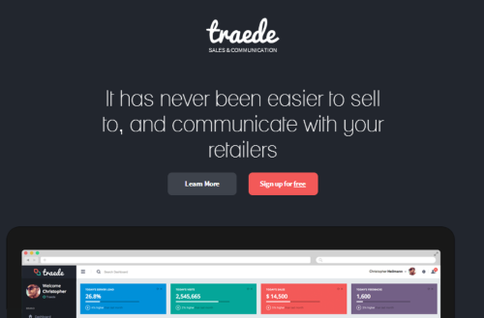
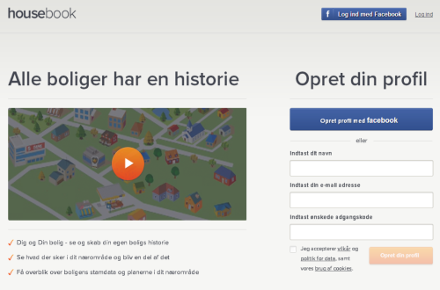
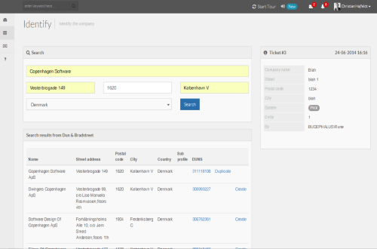
traede ”Simple B2B webshop for brands"
housebook ”Every home has a history”
MDM ”A glorified duplicates checker”
Notes:
As I have already stated, most of my other clients cannot teach you guys anything. From a software development point of view, most of them are drooling idiots in comparison.
However, I’ve been working with a number of start-ups recently, and since they are building new products just like we were on the ITXg team, I’ve thought about what they might have taught us.
Build less:
Trying to beat competition by having more features and spending more money on product development is a dead end. It worked for Ronald Reagan during the Cold War, but it won’t work for a start-up today.
Less features
Less options / preferences
Less options and preferences do not only mean that it will be easier and cheaper to write the code to implement these features. It means that it is more likely you will be able to buy these options and features as ready-made services.
Even facebook are going simple: they are splitting their Facebook app into a separate message app. But the quintessential representative for this must be Yo!. It is basically a messaging app, but without the messages! All you can do with Yo! is send a friend a notification saying ”Yo”. Actually, Yo started out as an app where you would write a question mark for ”how are you” and an exclamation point for ”I’m great!”. Now they’ve done away with the question mark and the exclamation point. Yo recently got $1M of funding from a business angel.
We have made a deal with one of our clients that we can take the internal tool that I’be built for them and turn it into a proper product. For them, it is a great deal because they will get a real product with regular updates and bugfixes, support, a service level agreement, etc., and they will not have to set aside any of their own developers to support the tool. For our part, it is a great deal because we will slap on one of these skins, put up a website based on one of those designs, set up a phone service and a Zendesk support center, and suddenly we have what looks to be a mature product, even though it is really just a bespoke solution that we have built for a single client. We can do this very cheaply, because the core value proposition is implemented in the tool that we get for free from our client. In that way, this is an application of the strategic design principles that will allow us to go to market very quickly

Slide 5
Building software with services

Slide 6


Slide 7

Value propositions
Easily buy and sell niche video content
Do contract negotiations
Build TV-channels, incl. ads
Deliver content to STBs
LinkedIn-style communication
…

Slide 8
History
Started in Denmark early 2010
Handed over to UK early 2011
Ended in UK early 2012
10-20 programmers and designers
Loads of different technologies
External partners
Consultants
Notes:
External partners: design company, head-end team, external hosting provider
When you start flying in consultants from Denmark, it is not a low-budget project anymore.

Slide 9
Strategic Software Construction

Slide 10
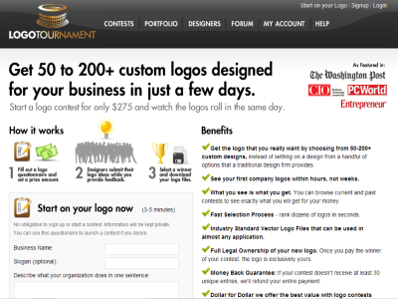
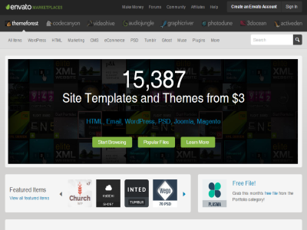

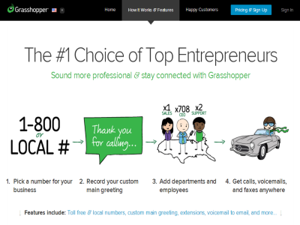
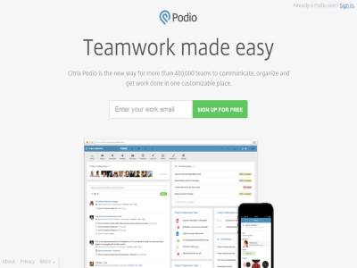
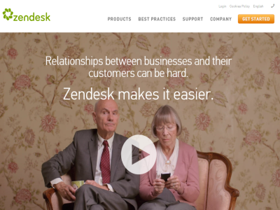
Notes:
Starting a business is pretty trivial. If you don’t want to do the paperwork yourself, you can usually get someone to do it for you for a very small fee.
Buying a domain and email services is trivial and very cheap.

Slide 11
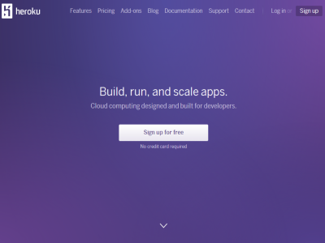

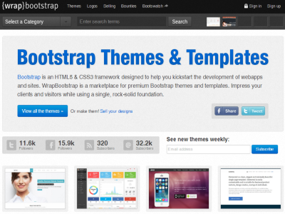
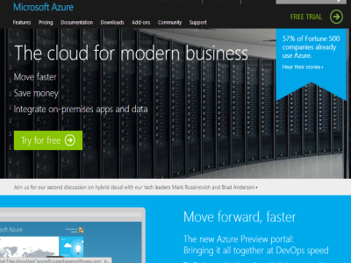
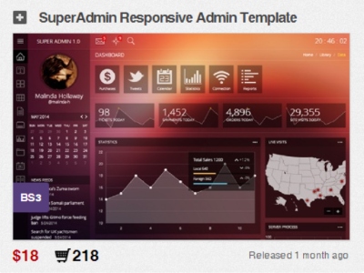
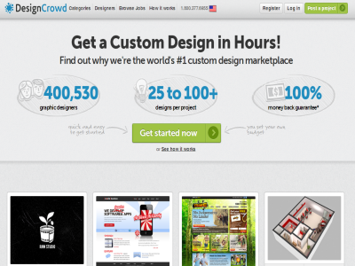
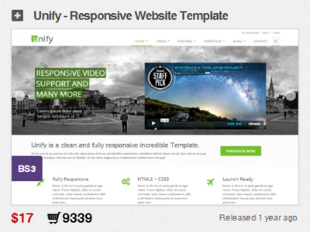
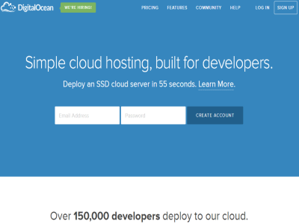
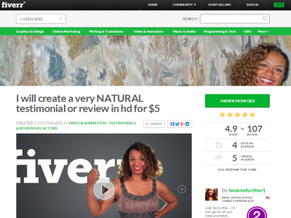
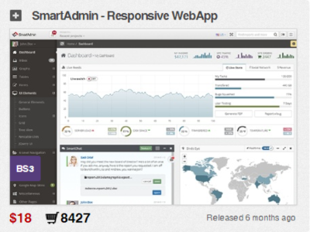
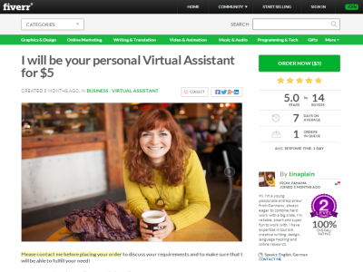
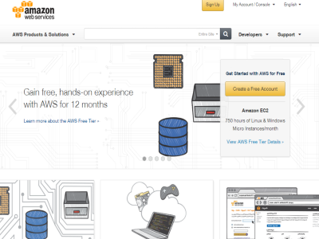
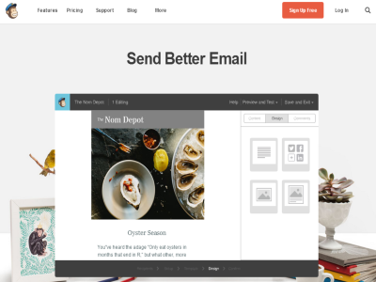
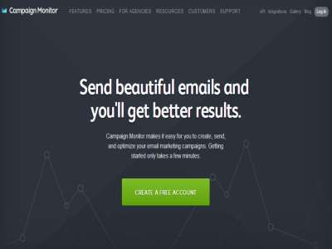
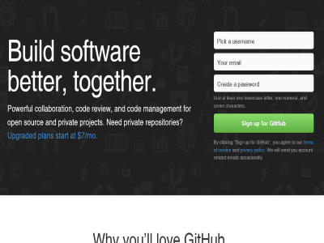
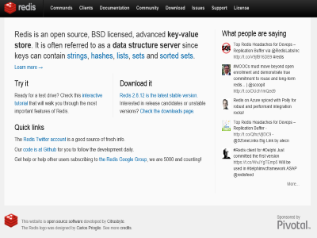
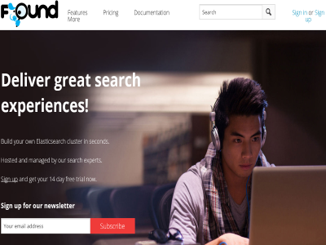
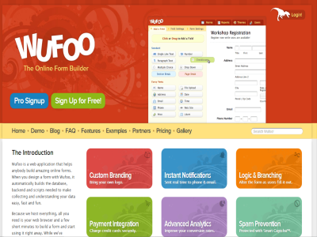

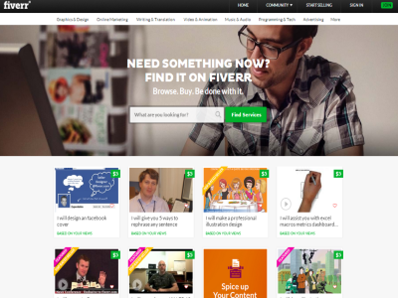
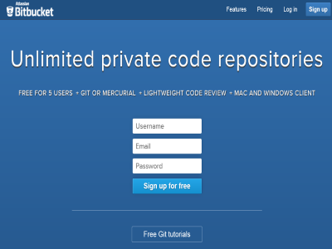
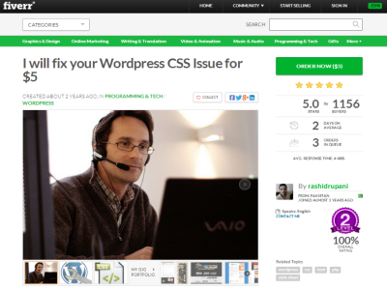
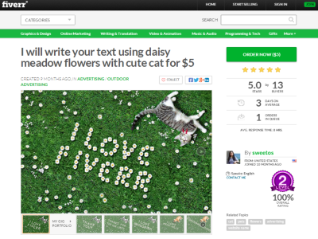
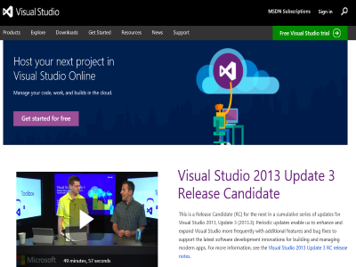
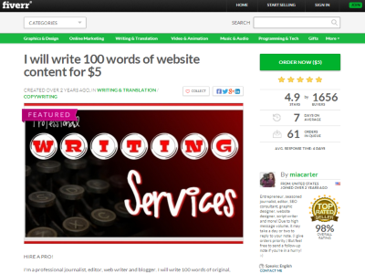
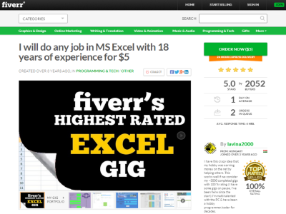
Notes:
Fiverr can be used to do write text, do translation, create videos, implement a given skin in Wordpress

Slide 12
You know your tools and how to build stuff with them.
Make sure you also know when not to build stuff.

Slide 13
Thank you

